Slide 1
Digital Electronics
Lab *: Logic Gate

Slide 2


Welcome to Digital Electronics Class

Slide 3

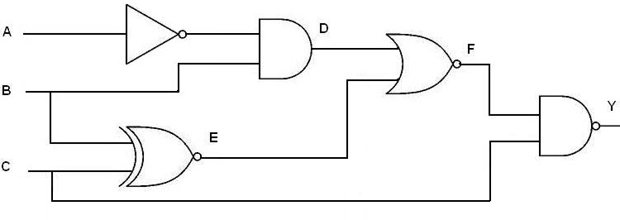
Logic Gates
Logic gates are the basic building blocks of any digital system. It is an electronic circuit having one or more than one input and only one output.

Slide 4
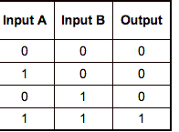
Truth Table
A truth table is simply a list of all possible input values to a logic gate (or really any digital circuit) and the output response for each input combination. We usually list the inputs in ascending binary order.

Slide 5
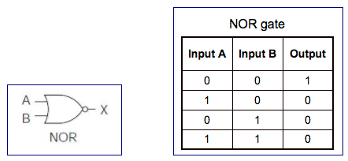
NOR Gate
The NOR gate is the complement of the OR gate and uses an OR graphic symbol followed by a small circle.

Slide 6
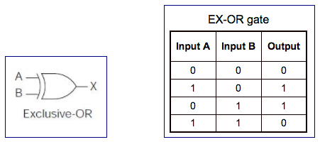
Exclusive-OR Gate (XOR)
The output of the gate is 1 if any input is 1 but excludes the combination when both inputs are 1.
It is similar to an odd function;that is, its output is 1 if an odd number of inputs are 1.

Slide 7
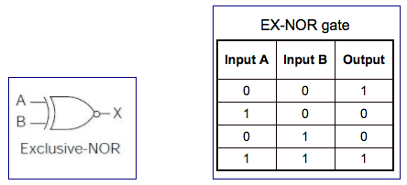
Exclusive-NOR Gate (XNOR)
The output of this gate is 1 only if both the inputs are equal to 1 or both inputs are equal to 0.

Slide 8
Boolean algebra
Boolean algebra is used to analyze and simplify the digital (logic) circuits.
It uses only the binary numbers i.e. 0 and 1.
It is also called as Binary Algebra or logical Algebra.
Boolean algebra was invented by George Boole in 1854.

Slide 9


Boolean Laws
Commutative law
Associative law
Distributive law
AND law
OR law
INVERSION law

Slide 10

Thank You!

